Slide 1






Slide 2


Slide 3

Training Institute
Educating since 1981
Flexible Timings
Quality Infrastructure
Super Trainers
Supportive Administration
Notes:
National Institute of Information and Technology.
Timeline
1981: NIIT was established by Rajendra S. Pawar and Vijay K. Thadani to optimise on the opportunity of booming IT education and training in India^{[10]}
1982: Setup educational centres in Mumbai and Chennai^{[11]}
1982: Introduced Multimedia technology in education
1983: Corporate training program introduced
1984: IT consultancy service started
1986: Software product distribution started under "Insoft" brand
1987: Conceived Franchising Model of education
1989: Dr CR Mitra an alumnus of MIT and former Director of BITS Pilani joined NIIT as education adviser stated and created "GNIIT" program^{[12]}
1991: First overseas office set up in US
1991: "Bhavishya Jyoti Scholarships" launched for meritorious and socially challenged students
1992: GNIIT program started with professional practice^{[13]}
1993: Received ISO 9001 for software export^{[14]}
1993: Listed on BSE
1995: NIIT tied up with Microsoft to provide education of Microsoft technologies
1996: First overseas education center launched
1996: Launched "NetVarsity", the virtual University
1996: Awarded ISO 9001 for Computer Education
1997: NIIT stated scholarship for economically under challenged children^{[15]}
1997: Unique distinction puts NIIT into first list of 21st Global companies^{[16]}
1999: Achieved the status of Microsoft's best training partner in Asia
2000: Tied up with Oracle Corporation to provide education on Oracle technologies specially on Oracle Database^{[17]}
2000: Collaborated with Sun Microsystems on "iForce initiatives on computing giant"^{[18]}
2001: Microsoft awarded NIIT the "Best Training Company Award"^{[19]}
2004: NIIT Technologies started offering Geographic Information Systems (GIS) to its clients^{[20]}
2004: NIIT and Intel signed a deal to use technology-assisted learning in school^{[21]}
2005: Germany based software company SAP AG and NIIT Technologies tied up to implement software projects for government and public sectors^{[22]}
2006: Sun Microsystems tied up NIIT to provide specialised training for students in programming platform such as Java and Solaris^{[23]}
2006: Launched two new businesses called NIIT Imperia which would provide three certificate programmes from Indian Institutes of Management and IFBI Institute of Finance Banking and Insurance (NIIT IFBI)^{[24]}
2008: Entered into alliance with Infospectrum India Pvt Ltd to cater Education Research and Planning (ERP) solution tolls with its school learning solution^{[25]}
2009: Founded and commenced new "NIIT University" campus in Neemrana, Rajasthan offering more post graduation level courses.^{[26]}
2009: Chinese Society of Educational Development Strategy (CSEDS) awarded NIIT Ltd for IT Training Brand in China^{[27]}
2013: NIIT enters Test Preparation Market with CTET Coaching ^{[28]}

Slide 4


Slide 5
Reasons to choose Java
Fully Object-Oriented
Platform Independent
Architecture Neutral
Secure
Robust
Multi-threaded
Notes:
http://web.cs.wpi.edu/~cs525e/s01/java/features.html
Simple
Looks familiar to existing programmers: related to C and C++: Omits many rarely used, poorly understood, confusing features of C++, like operator overloading, multiple inheritance, automatic coercions, etc. Contains no goto statement, but break and continue Has no header files and eliminated C preprocessor Eliminates much redundancy (e.g. no structs, unions, or functions) has no pointers Added features to simplify:
Garbage collection, so the programmer won't have to worry about storage management, which leads to fewer bugs. A rich predefined class library
Object-Oriented
Java is an object-oriented language, which means that you focus on the data in your application and methods that manipulate that data, rather than thinking strictly in terms of procedures. In an object-oriented system, a class is a collection of data and methods that operate on that data. Taken together, the data and methods describe the state and behavior of an object. Classes are arranged in a hierarchy, so that a subclass can inherit behavior from its superclass.
Java comes with an extensive set of classes, arranged in packages, that you can use in your programs.
Distributed
It has a spring-like transparent RPC system Now uses mostly tcp-ip based protocols like ftp & http Java supports various levels of network connectivity through classes in the java.net package (e.g. the URL class allows a Java application to open and access remote objects on the internet).
Interpreted
The Java compiler generates byte-codes, rather than native machine code. To actually run a Java program, you use the Java interpreter to execute the compiled byte-codes. Java byte-codes provide an architecture-neutral object file format. The code is designed to transport programs efficiently to multiple platforms.
rapid turn-around development Software author is protected, since binary byte streams are downloaded and not the source code
Robust
Java has been designed for writing highly reliable or robust software: language restrictions (e.g. no pointer arithmetic and real arrays) to make it impossible for applications to smash memory (e.g overwriting memory and corrupting data) Java does automatic garbage collection, which prevents memory leaks extensive compile-time checking so bugs can be found early; this is repeated at runtime for flexibilty and to check consistency
Secure
Security is an important concern, since Java is meant to be used in networked environments. Without some assurance of security, you certainly wouldn't want to download an applet from a random site on the net and let it run on your computer. Java's memory allocation model is one of its main defenses against malicious code (e.g can't cast integers to pointers, so can't forge access). Furthermore: access restrictions are enforced (public, private) byte codes are verified, which copes with the threat of a hostile compiler
Architecture-Neutral
compiler generates bytecodes, which have nothing to do with a particular computer architecture easy to interpret on any machine
Portable
Java goes further than just being architecture-neutral: no "implementation dependent" notes in the spec (arithmetic and evaluation order) standard libraries hide system differences the Java environment itself is also portable: the portability boundary is POSIX compliant
High-Performance
Java is an interpreted language, so it will never be as fast as a compiled language as C or C++. In fact, it is about 20 times as slow as C. However, this speed is more than enough to run interactive, GUI and network-based applications, where the application is often idle, waiting for the user to do something, or waiting for data from the network.
Multithreaded
Java allows multiple concurrent threads of execution to be active at once. This means that you could be listening to an audio clip while scrolling the page and in the background downloading an image. Java contains sophisticated synchronization primitives (monitors and condition variables), that are integrated into the language to make them easy to use and robust. The java.lang package provides a Thread class that supports methods to start, run, and stop a thread, and check on its status.
Dynamic
Java was designed to adapt to an evolving environment:
Even after binaries have been released, they can adapt to a changing environment Java loads in classes as they are needed, even from across the network It defers many decisions (like object layout) to runtime, which solves many of the version problems that C++ has Dynamic linking is the only kind there is

Slide 6
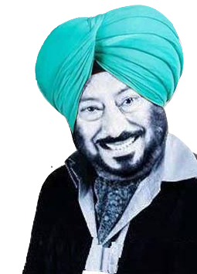
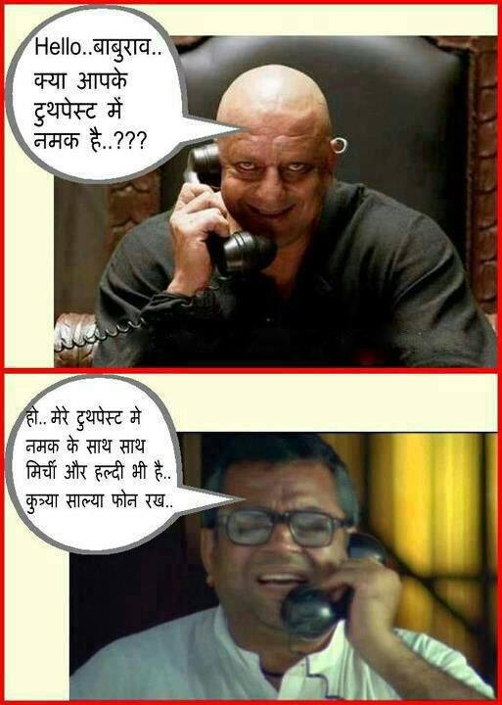








Slide 7
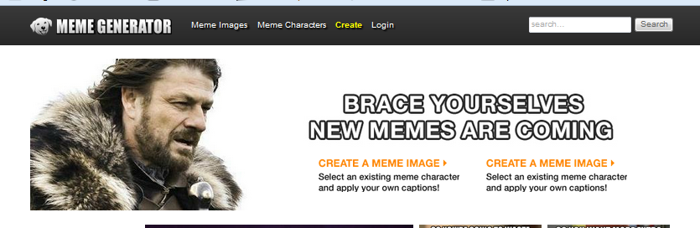
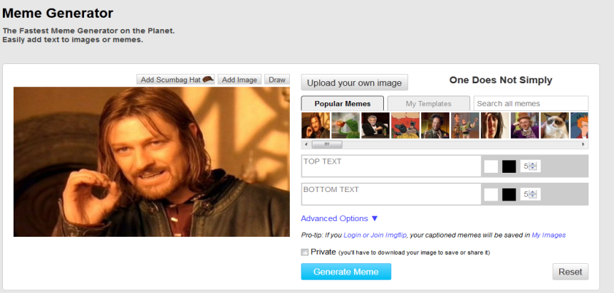
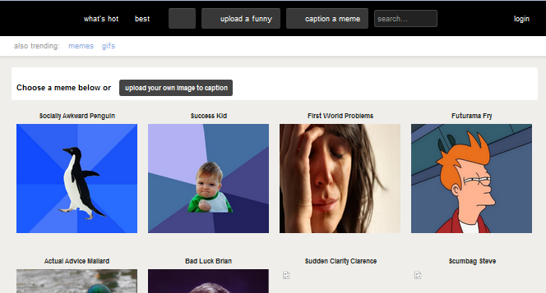
Few Meme Generating Websites
www.memegenerator.net/
www.imgflip.com/
www.quickmeme.com/
www.memecreator.org
and many more……
Notes:
memegenerator.net/
https://imgflip.com/
www.quickmeme.com/
www.memecreator.org

Slide 8
Trollify
Meme Generating Application

Slide 9
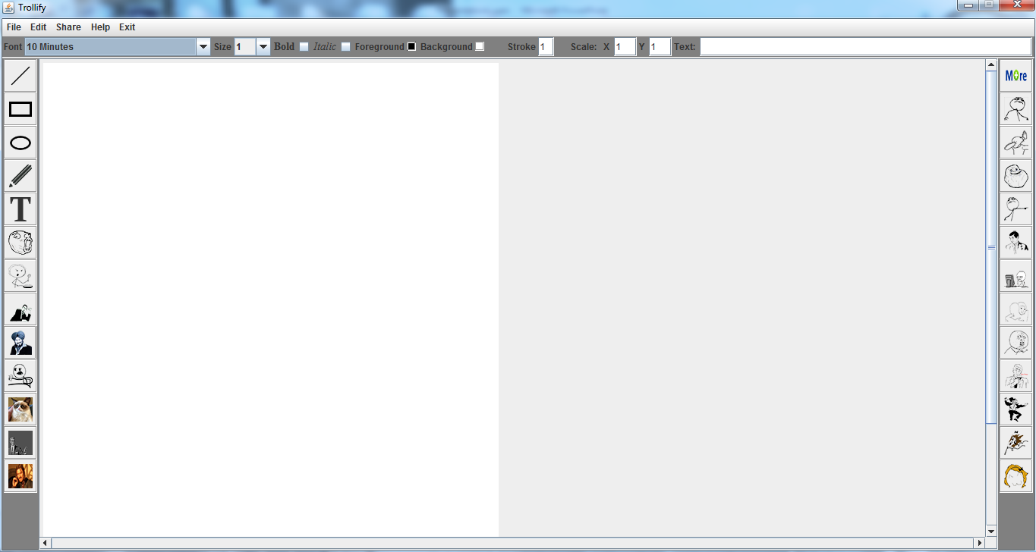
Design
Main Frame of Trollify

Slide 10
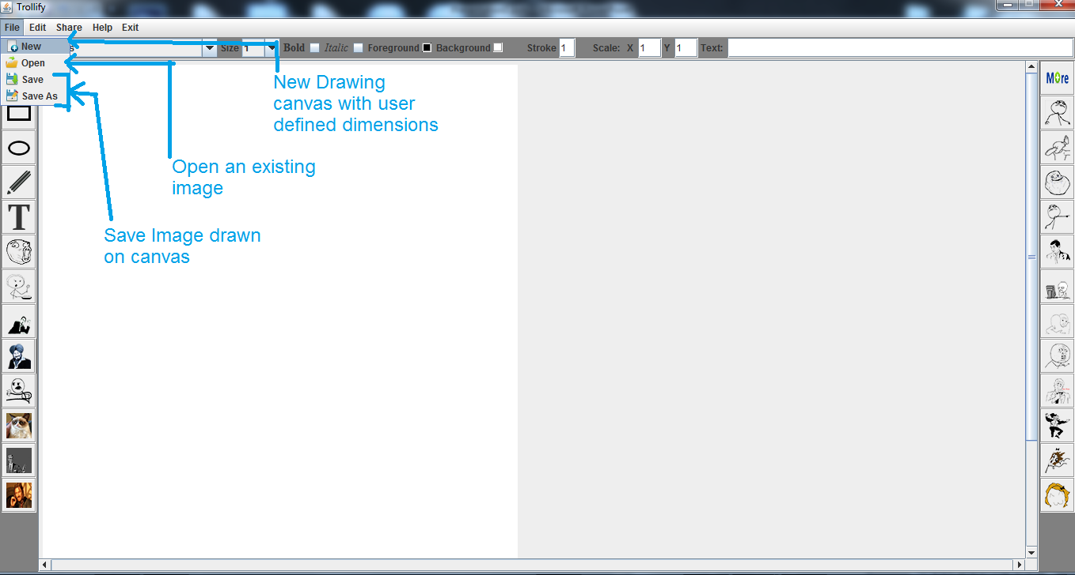
Design

Slide 11
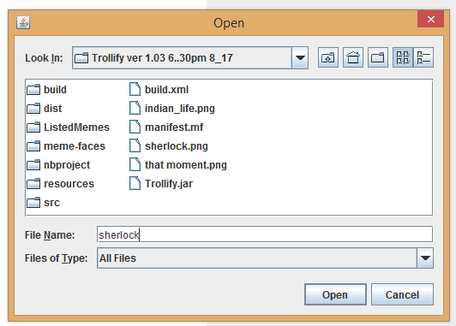
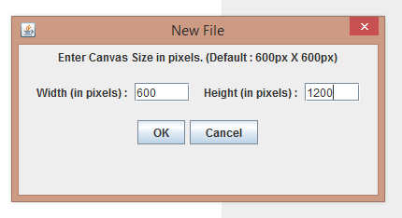
Design

Slide 12
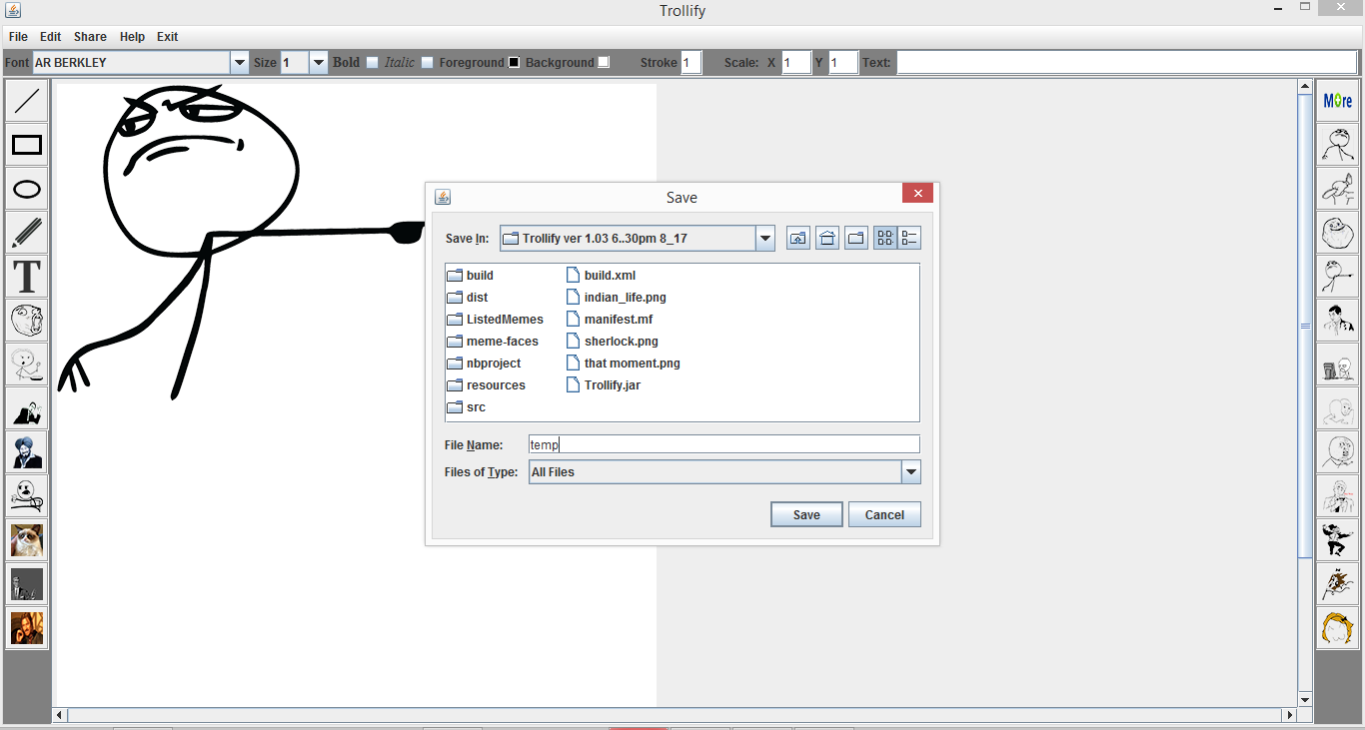
Design

Slide 13
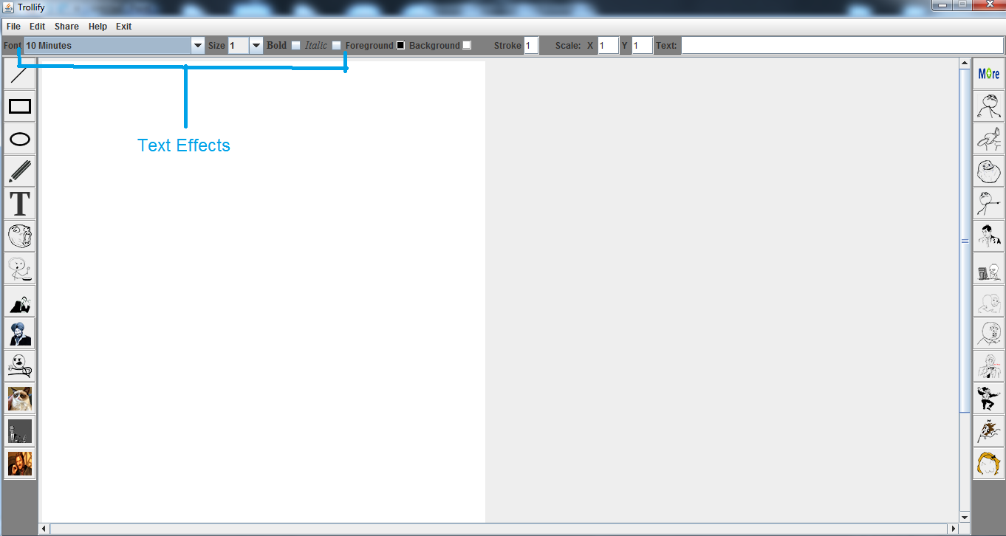
Design

Slide 14
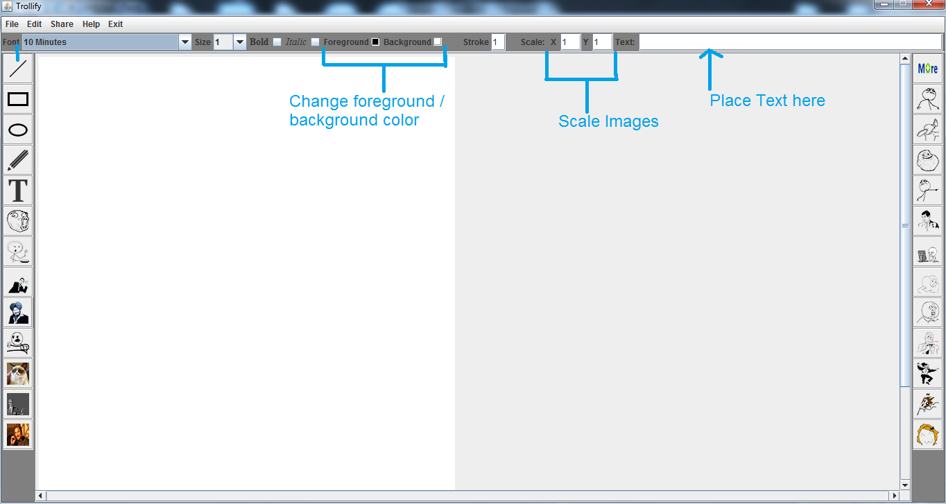
Design

Slide 15
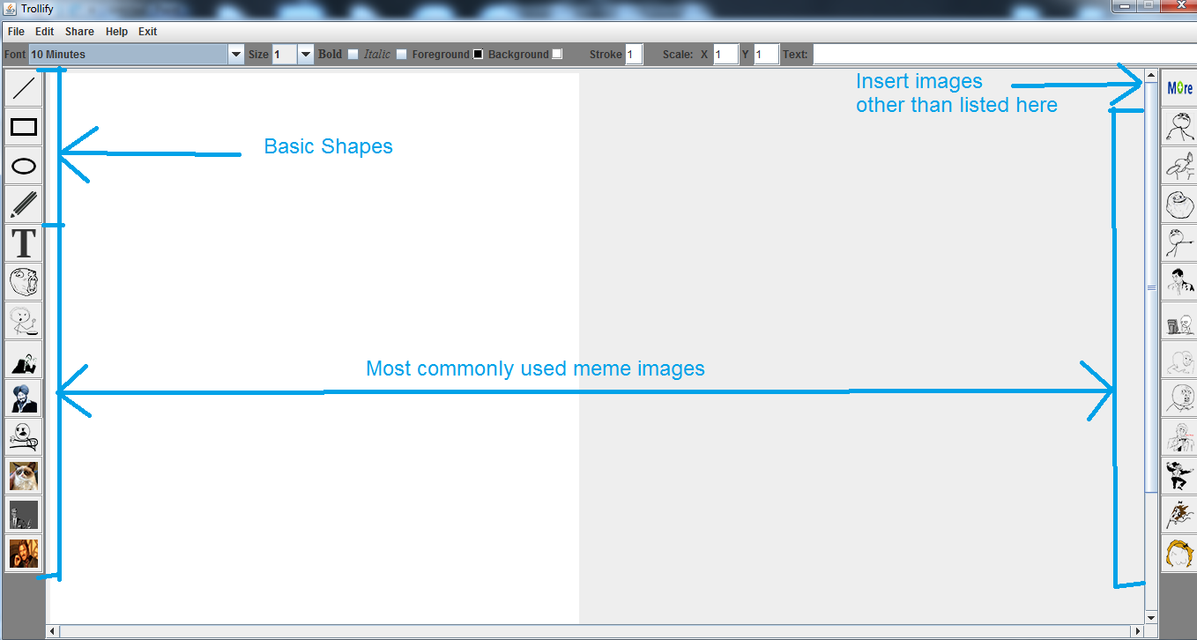
Design

Slide 16

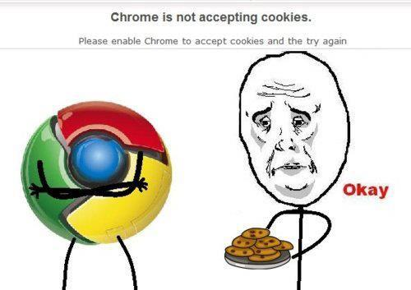
Sample Images Created using Trollify

Slide 17
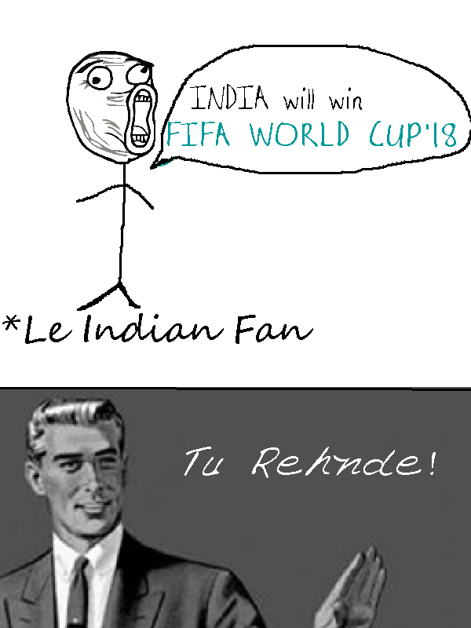

Sample Images Created using Trollify

Slide 18

Scope of Improvement
Reduction in Memory Usage
Addition of features
(Eg: Sharing on FB, Twitter etc)
Enhance Usability
More Image Editing Options
Regular patching of bugs

Slide 19
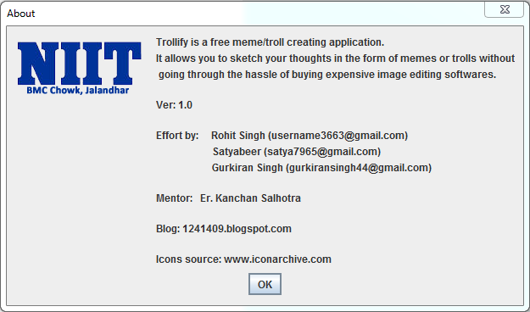
Credits
Official Blog: 1241409.blogspot.com

